Slide 1
Vacation Trip Planner
Group 6 | Anastasiya Osher, Elizabeth Chang, Alan Nguyen, Timothy Li

Slide 2
Overview
This program contains a database of information regarding travel destinations with their respective currency, most popular tourist location, and ticket price from SFO for the week for 3/31/17. We use a city’s airport code as our primary key and the city’s name as our secondary key.
Data
Airport Code (Primary Key)
City Name (Secondary Key)
Currency
Best known tourist location
Airplane ticket price (in $)
Purpose:
With this program, we can compare awesome travel destinations and determine where to travel to in the spring! With important data about each city, we can easily find and plan where to travel to.

Slide 3
Assignments
Team Coordination: Alan Nguyen
BST Algorithms: Timothy Li
Hash List Algorithms: Anastasiya Osher
Screen Output: Elizabeth Chang
File I/O: Elizabeth Chang
Project Documentation: Alan Nguyen

Slide 4
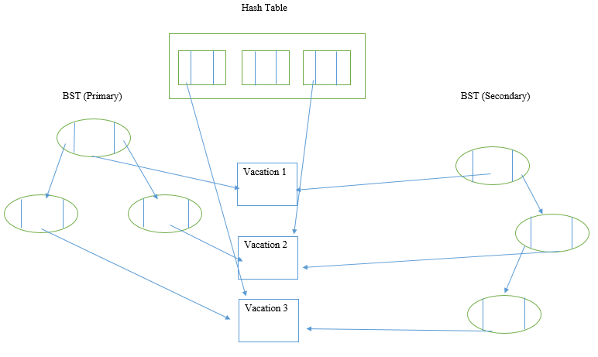
Data Structure Diagram

Slide 5
UML Diagrams
Vacation, BinaryTree, BinarySearchTree, BinaryNode

Slide 6
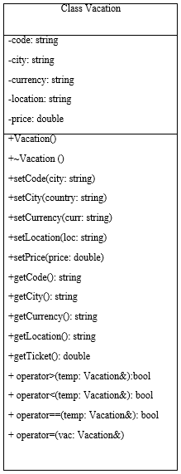
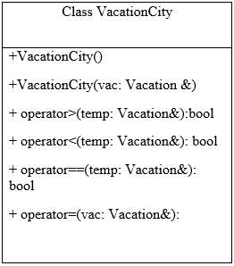

Slide 7
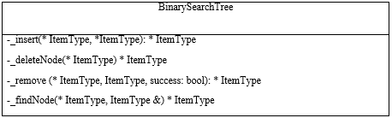
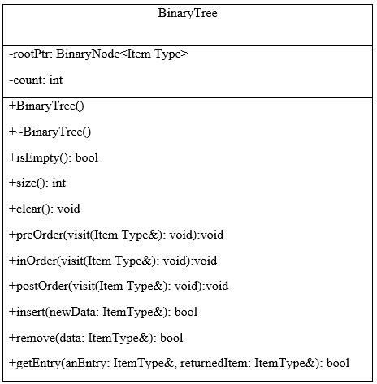
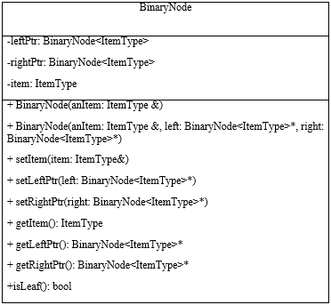

Slide 8
Structure Chart

Slide 9
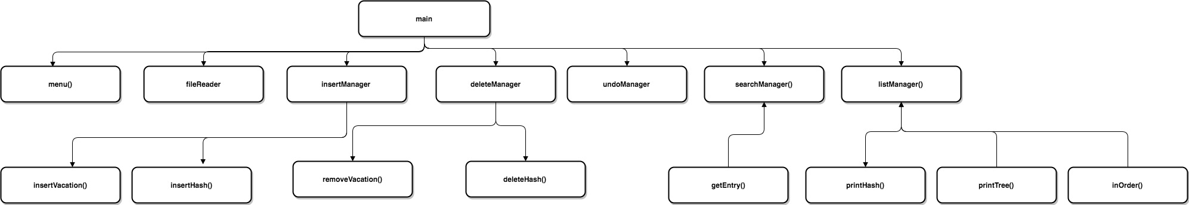
Main Structure Chart
Notes:
heres the link to the structure chart:
https://www.draw.io/#Hstylate%2FvacationPlanner%2Fmaster%2FStructureChart

Slide 10
Hash Function
and Resolution

Slide 11
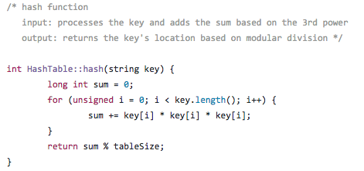
Good Hash Function
Table size: 53
Total number of elements: 25
Total number of Collisions: 3
Total load Factor: 20/53 => 37.74%

Slide 12
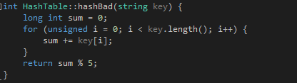
Bad Hash Function

Slide 13
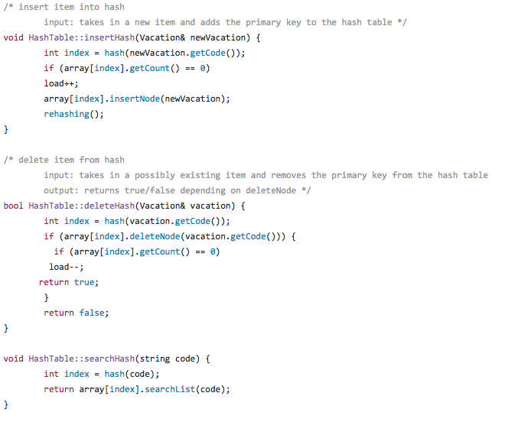
Hash Function Code:

Slide 14
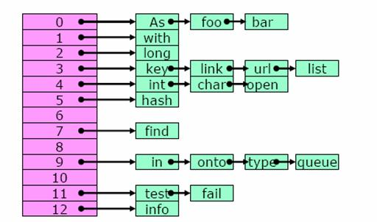
Resolution Method: Linked List
Otherwise known as separate chaining, we create a linked list (like shown below) for collision resolution:

Slide 15
Code Demonstration

Slide 16
Thanks!
ANY QUESTIONS?

